Slide 1


BTEC Level 2
Art & Design Skills
Sample Marked Learner Work
A2: Art and Design Project
Version 1.0 – July 2020

Slide 2

Contents
 |  | Page
1 | Introduction | 3
2 | Commentary | 4
3 | Assignment Brief – Op and Pop | 6
4 | Learner work | 17
6 | Record of Practical Activity | 43
7 | Assessment Record Sheet | 44
You will need to refer to the appropriate specification alongside these sample materials.
The specification for the BTEC Level 2 in Art and Design Skills can be found by typing the following into your web browser:
https://qualifications.pearson.com/en/qualifications/btec-firsts/BTEC-Level-2-in-Art-and-Design-Skills.html
Sample Marked Learner Work | A2: Art and Design Project
2

Slide 3
Introduction
This sample of learner work is for the BTEC Level 2 in Art and Design Skills. For this module, the learners have produced work in response to an assignment brief to provide evidence for assessment of Unit A2: Art and Design Project. The assignment brief used for generating this learner work has been written by the centre and has been contextualised to the centres delivery plans and requirements. The assignment briefs have been included here for information only and some key information has been removed.
The learner work that follows has been assessed accurately to national standards. This is one example of a mixture of Merit and Distinction grade achievement for the following Assessment Criteria:
A2.1 Carry out investigation for an art and design project - Distinction
A2.2 Use communication skills for an art and design project - Merit
A2.3 Use practical skills for an art and design project - Distinction
A2.4 Carry out development of an art and design project - Distinction
A2.5 Use productive approaches to working for an art and design project - Merit
Please note:
This is just one example of how learners can achieve this unit. Centres may use a variety of delivery and assessment methods, providing the emphasis is on learners demonstrating the skills covered by the assessment criteria.
Some elements of the learner work and assessment paperwork in these materials have been blurred out to ensure anonymity.
Although documentation is not included for the purposes of this document:
all assignment briefs must be internally verified before being released to learners
all learners and assessors must sign a declaration authenticating the evidence as the learners’ own
We encourage you to use this work to standardise your assessment teams and demonstrate the level of response expected to achieve the different targeted grades outcome.
Sample Marked Learner Work | A2: Art and Design Project
3

Slide 4
Commentary
A2.1 | Carry out investigation for an art and design project | Distinction | 3 Point
The learner has undertaken a sustained investigation into a wide range of artists and designers related to the theme of the project including Bridget Riley, Victor Vasarely and Marc Jacobs. The work of others clearly informs and inspires the learners work and has been used to develop initial ideas and has effectively influenced the learners creative decision making. Exploration of materials, techniques and processes have allowed the learner to refine their initial ideas and develop work that demonstrates understanding of the theme.
A2.2 | Use communication skills for an art and design project | Merit | 2 Point
The learner has demonstrated an effective communication of intentions, project development and ideas throughout the project. There is a clear understanding and use of effective presentation methods and appropriate formats and conventions are in relation to the nature of the work. The learner has acknowledged some aspects of how the work will communicate initial intentions and concepts through the outcome. However a greater emphasis of how the presentation methods could really enhance the qualities of the work would be beneficial and could be explored further.
A2.3 | Use practical skills for an art and design project | Distinction | 3 Points
Generally the learner has demonstrated an assured selection and manipulation of media, materials, techniques and processes with a clear awareness of their effect on production of outcomes. There is generally consistent application of practical skills shown through development and execution which demonstrates understanding of how to exploit media, materials, techniques and processes to realise creative intentions.
Sample Marked Learner Work | A2: Art and Design Project
4

Slide 5
Commentary
A2.4 | Carry out development of an art and design project | Distinction | 3 Points
The learner has shown sound use of ideas generation, experimentation, review and refinement across the assignment. The development towards a final outcome has been sustained throughout each step of the design and production cycle and this has allowed the learner to produce a refined and sophisticated response to the brief. It is clear that the learner has used the results of on going experimentation and exploration to allow the work to evolve. The creative process has been recorded in a logical and systematic fashion.
A2.5 | Use productive approaches to working for an art and design project | Merit | 2 Point
The learner has worked mostly independently throughout the project and has clearly engaged well with the brief. The project is well managed and submitted on time and the work presented is well organised and provides an clear narrative to the work undertaken. The learner had demonstrated a competent understanding of health and safety and has taken appropriate measures to protect herself and others when working practically. Evidence for this criteria has also been collected in the form of a Record of Practical Activity completed by the assessor.
General Comments
In this assessment unit, learners apply their learning synoptically to complete a project in response to a vocationally relevant brief. The practical skills evident in the learner’s work are competent and indicative of the Merit/Distinction assessment criteria at this level. When undertaking project work, it is recommended that learners engage equally with the five fundamental skill areas (investigation, communication, practical skills, development and approach) in an integrated way when developing their work.
Sample Marked Learner Work | A2: Art and Design Project
5

Slide 6
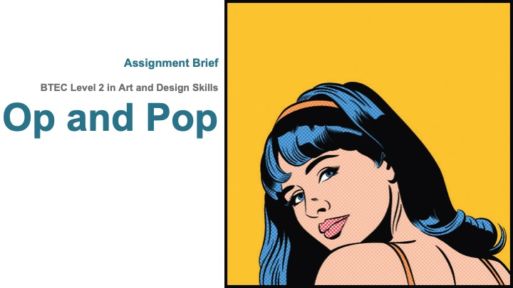
Assignment Brief
Sample Marked Learner Work | A2: Art and Design Project
6

Slide 7
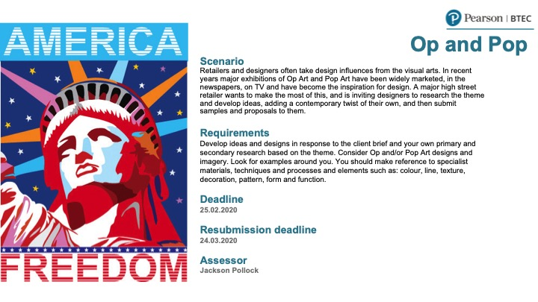
Sample Marked Learner Work | A2: Art and Design Project
7

Slide 8
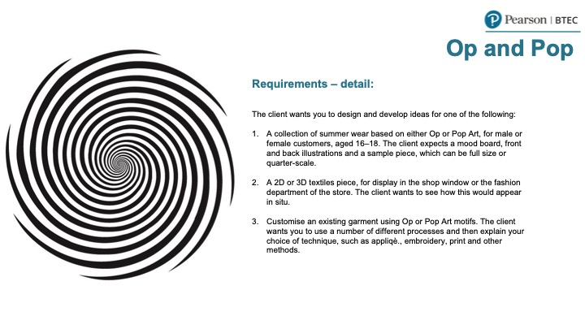
Sample Marked Learner Work | A2: Art and Design Project
8

Slide 9
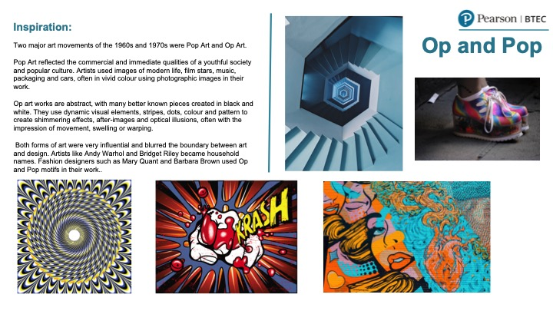
Sample Marked Learner Work | A2: Art and Design Project
9

Slide 10
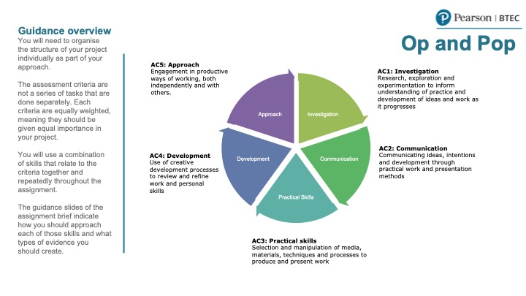
Sample Marked Learner Work | A2: Art and Design Project
10

Slide 11
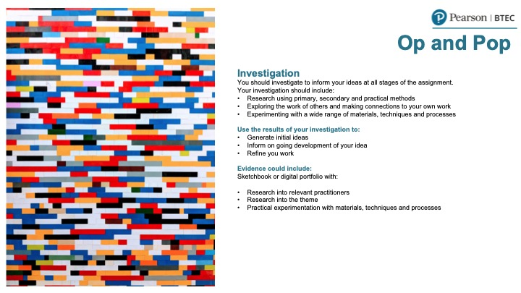
Sample Marked Learner Work | A2: Art and Design Project
11

Slide 12
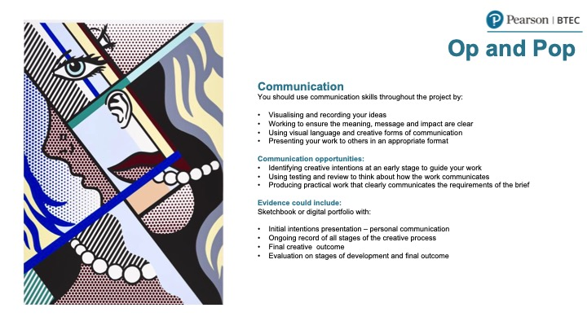
Sample Marked Learner Work | A2: Art and Design Project
12

Slide 13
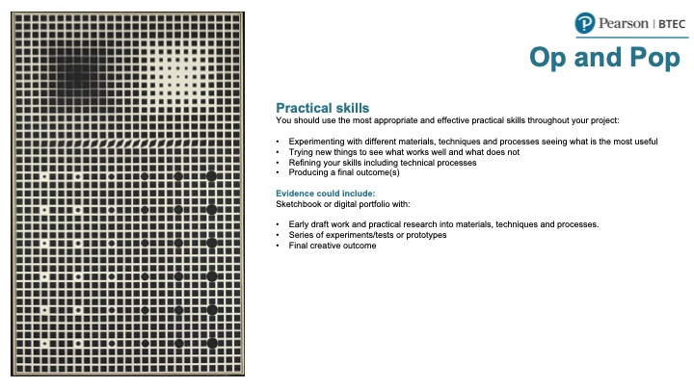
Sample Marked Learner Work | A2: Art and Design Project
13

Slide 14
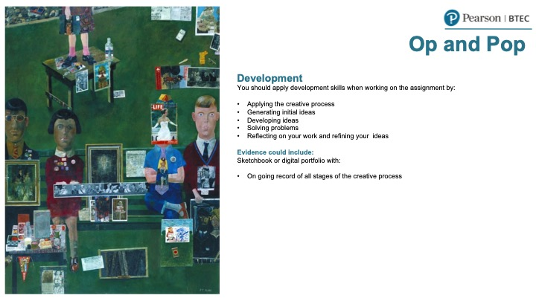
Sample Marked Learner Work | A2: Art and Design Project
14

Slide 15
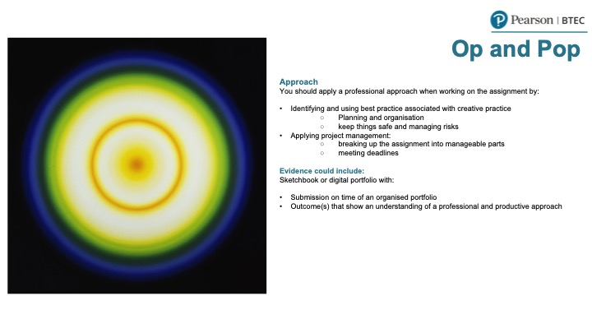
Sample Marked Learner Work | A2: Art and Design Project
15

Slide 16
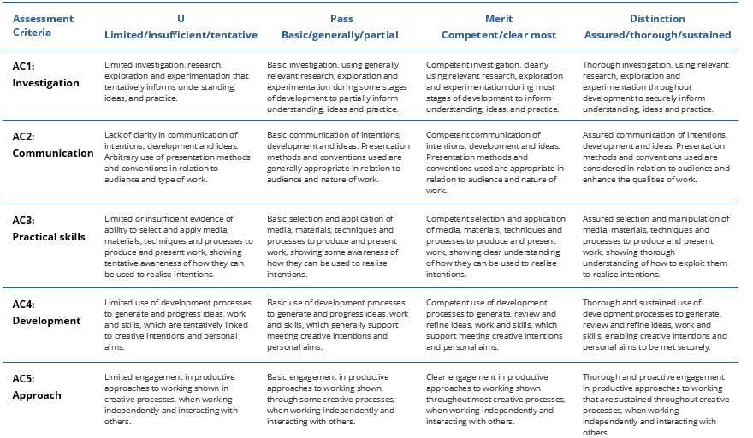
Sample Marked Learner Work | A2: Art and Design Project
16

Slide 17
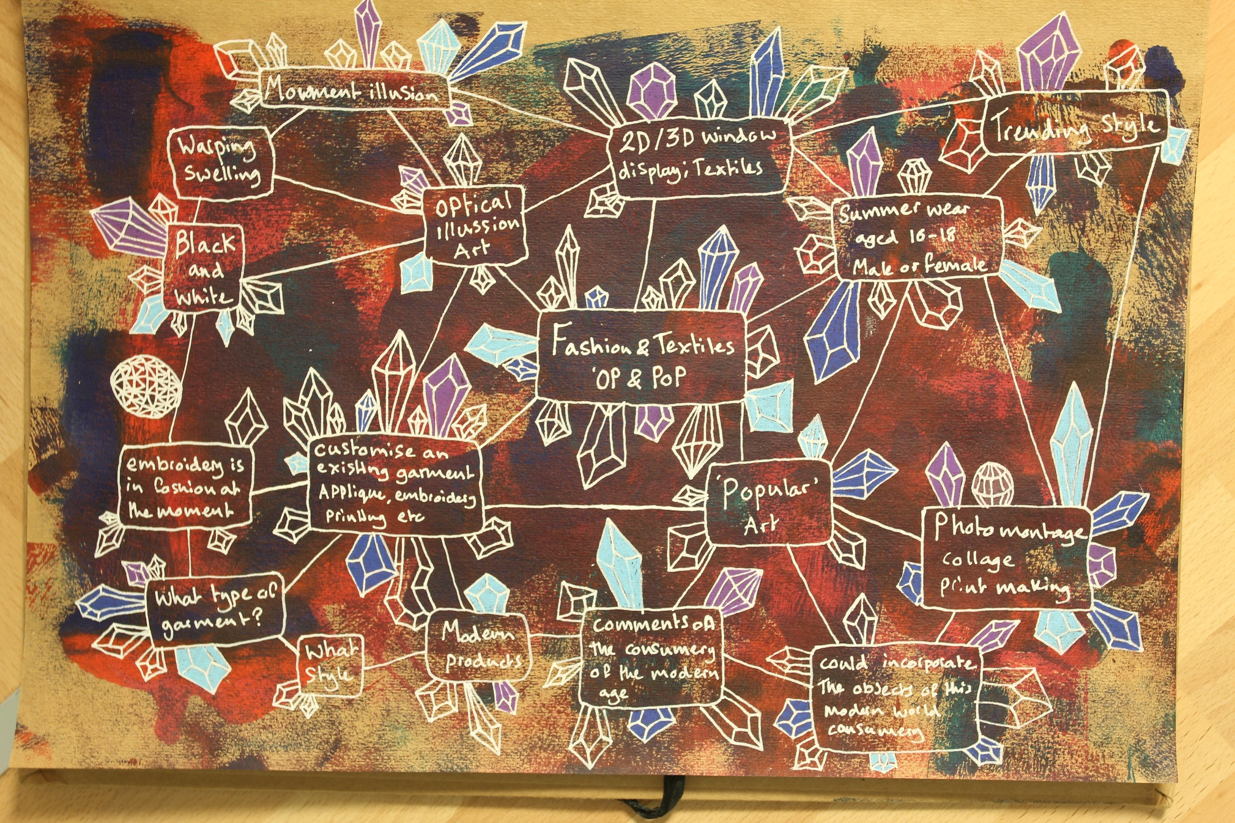
Learner Work
Sample Marked Learner Work | A2: Art and Design Project
17

Slide 18
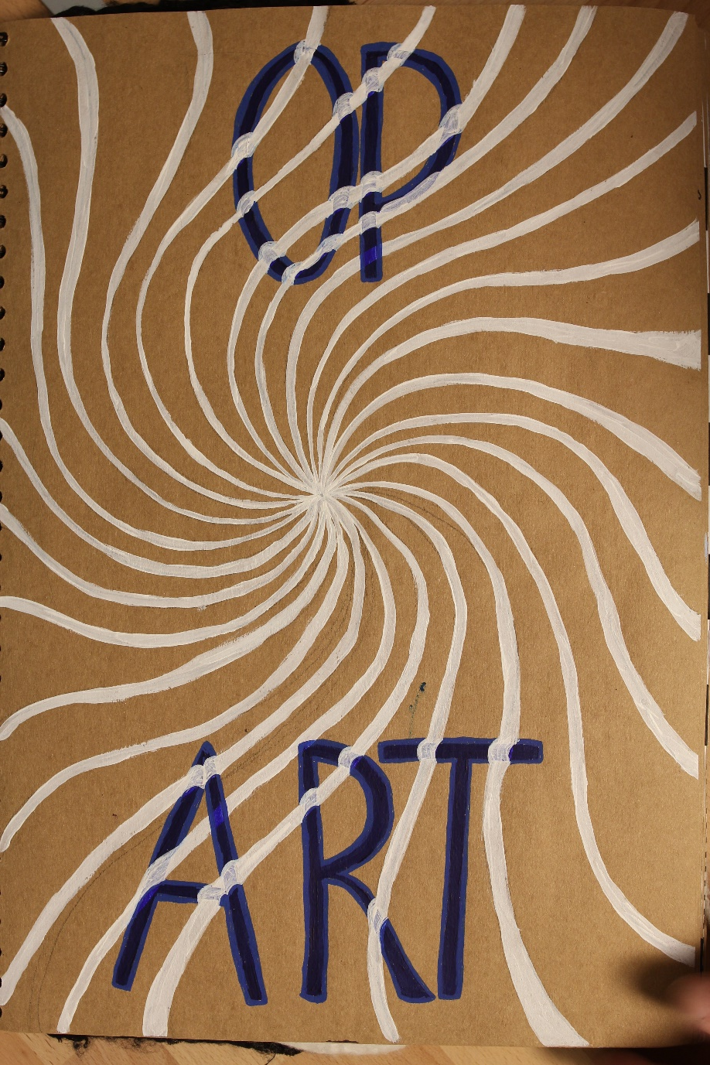
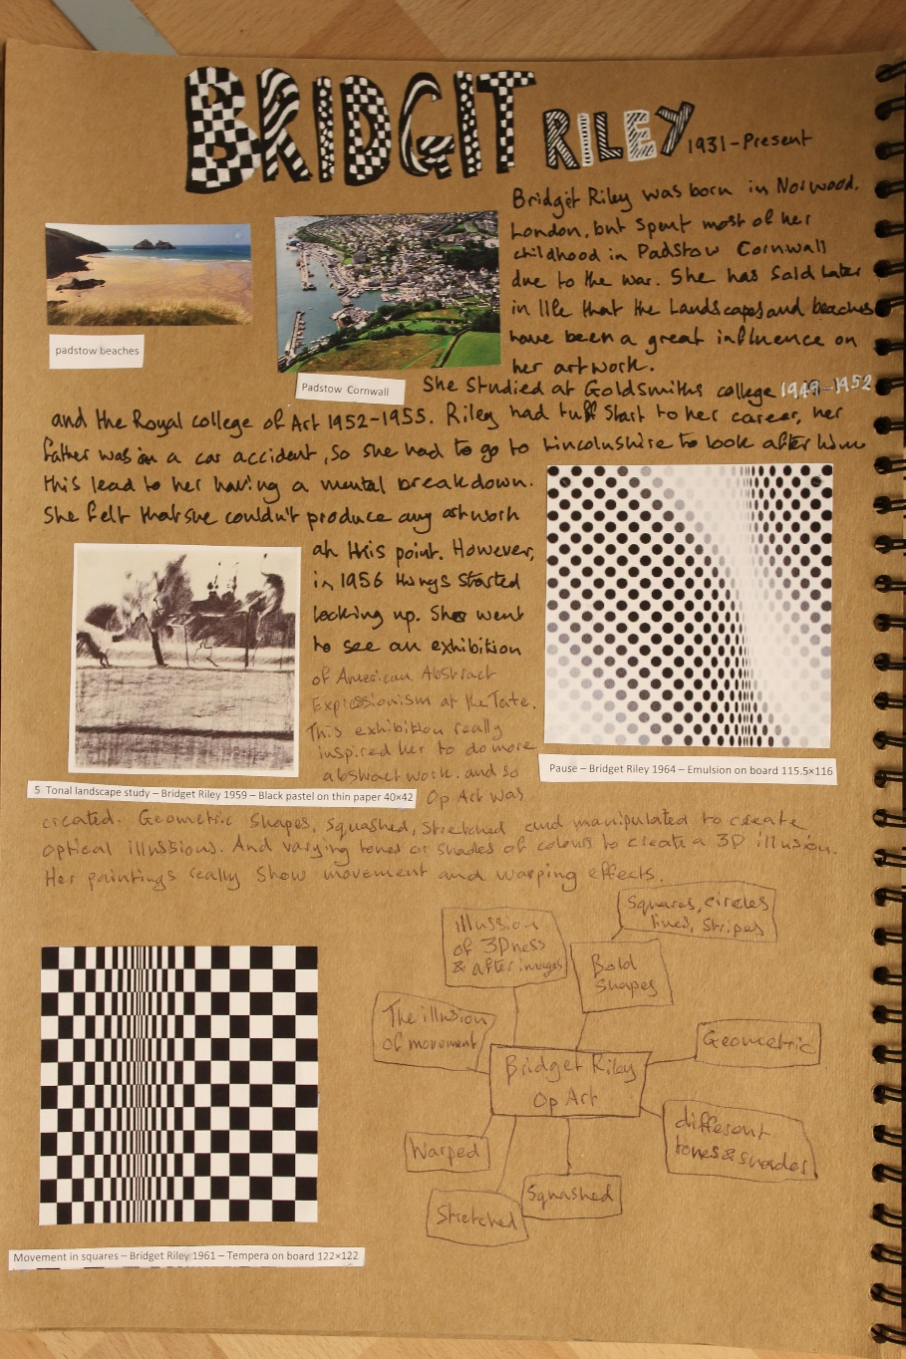
Sample Marked Learner Work | A2: Art and Design Project
18

Slide 19
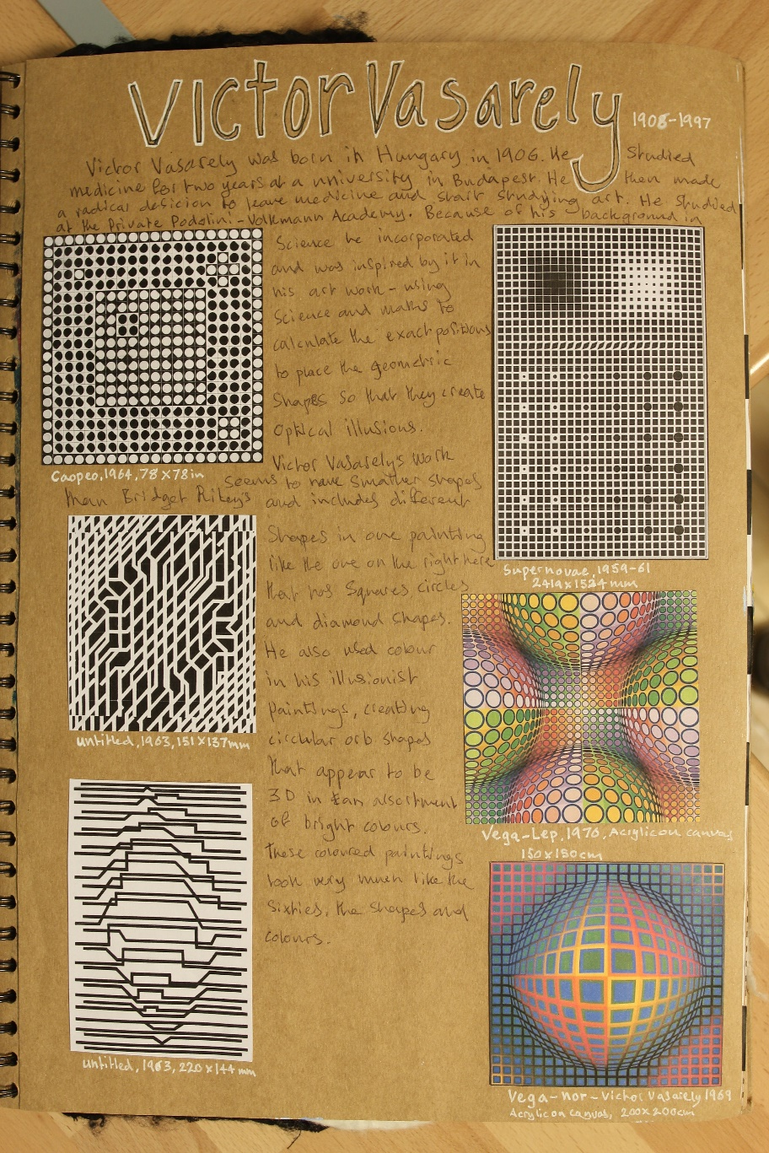
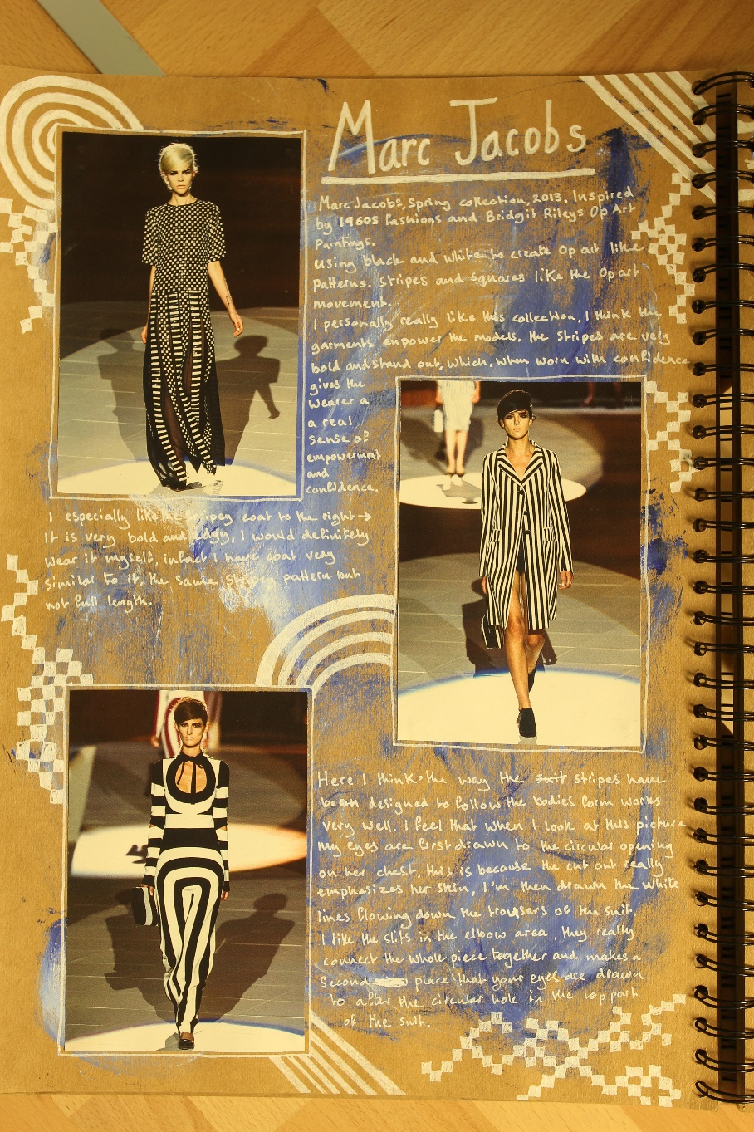
Sample Marked Learner Work | A2: Art and Design Project
19

Slide 20
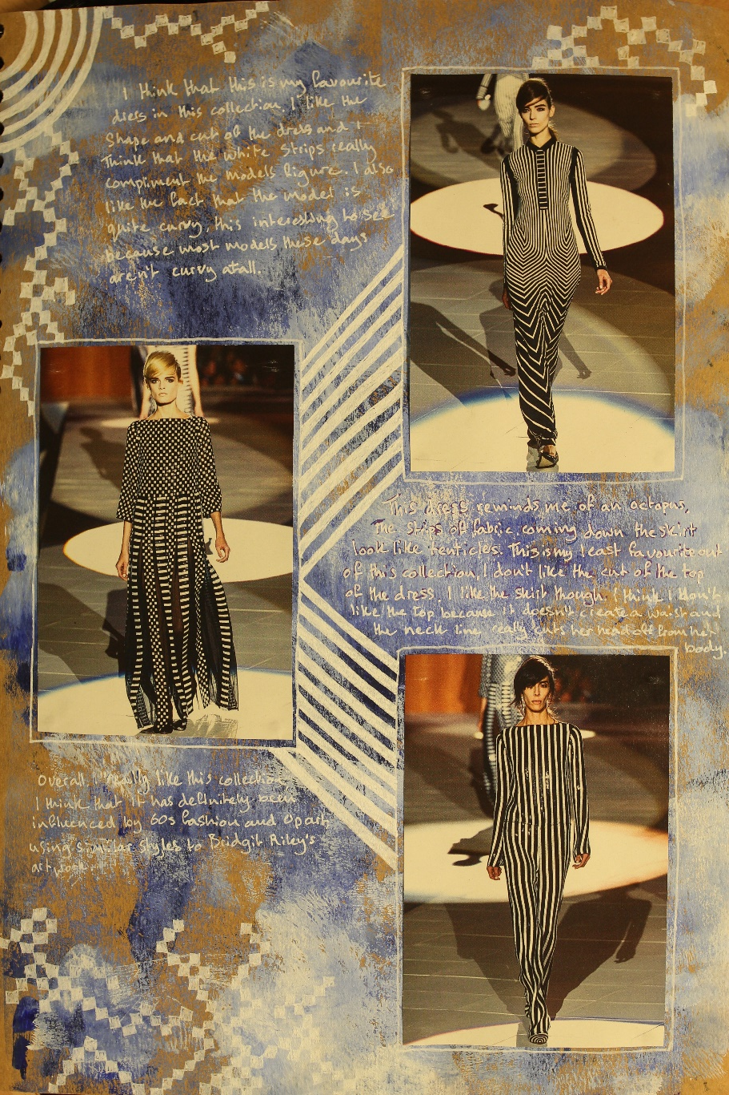
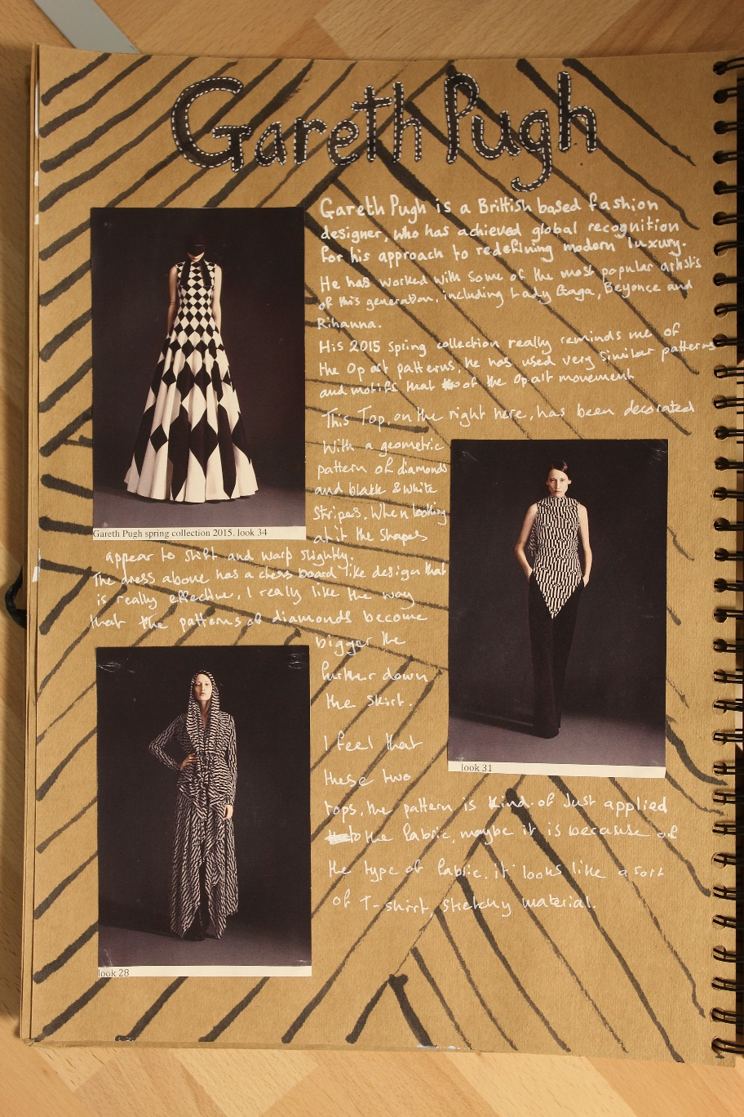
Sample Marked Learner Work | A2: Art and Design Project
20

Slide 21
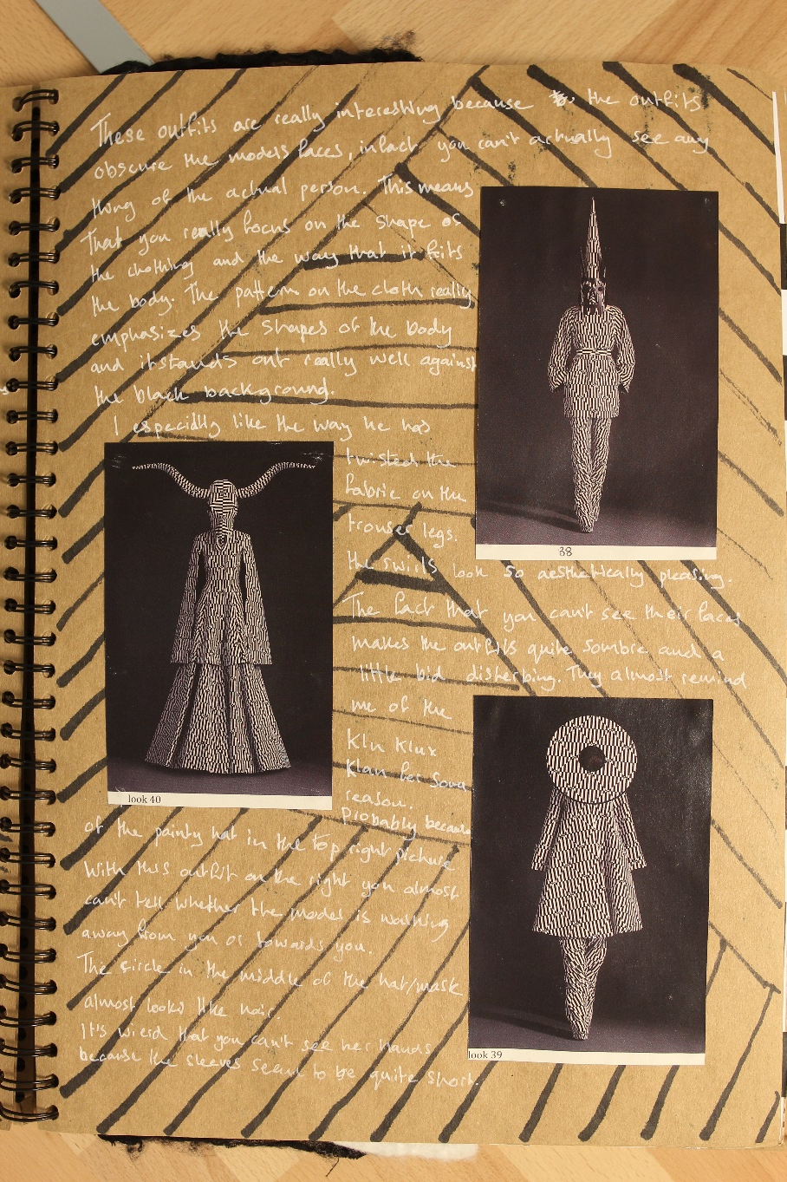
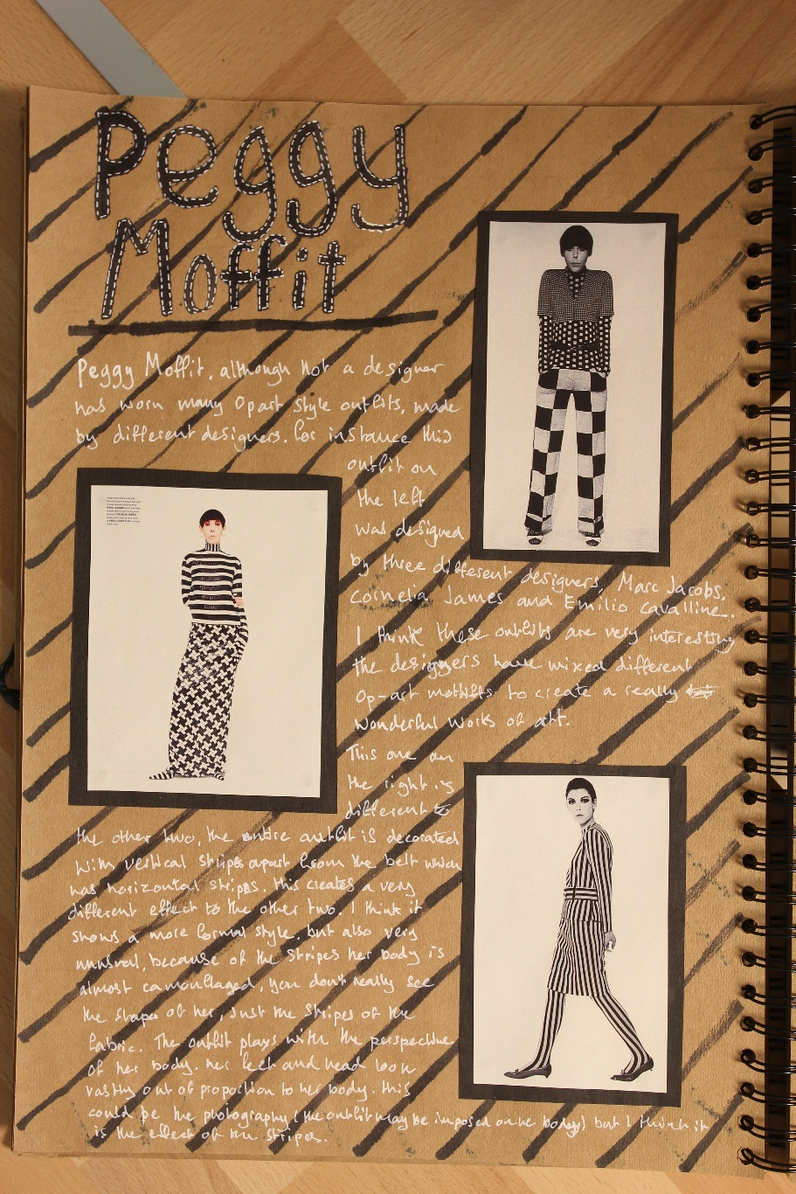
Sample Marked Learner Work | A2: Art and Design Project
21

Slide 22
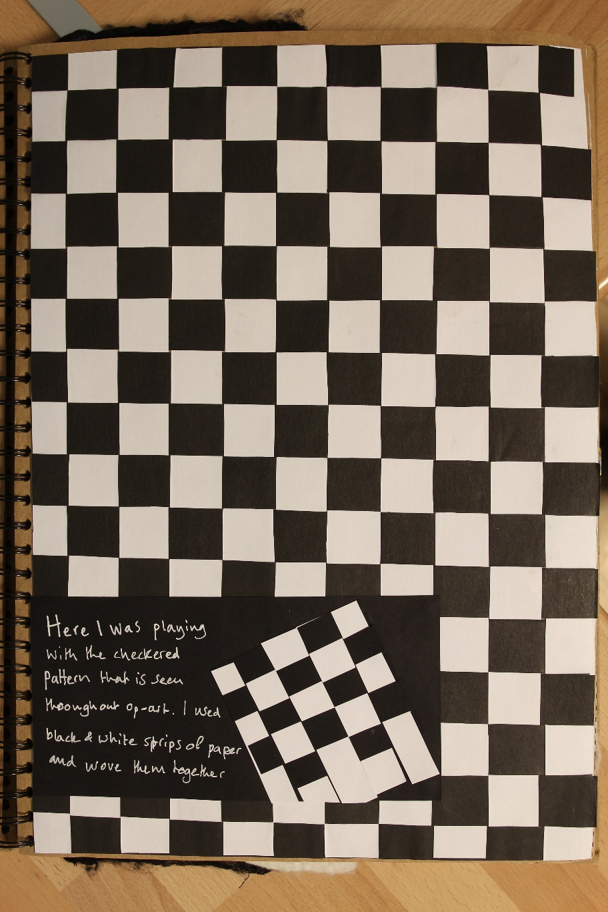
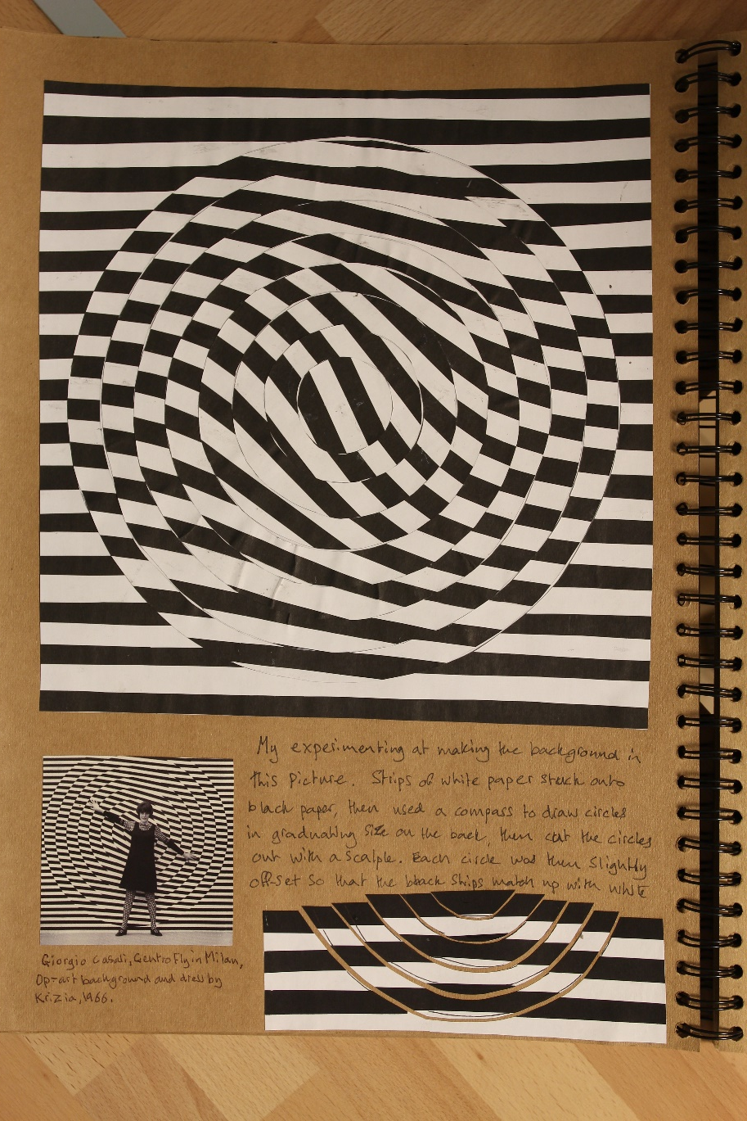
Sample Marked Learner Work | A2: Art and Design Project
22

Slide 23
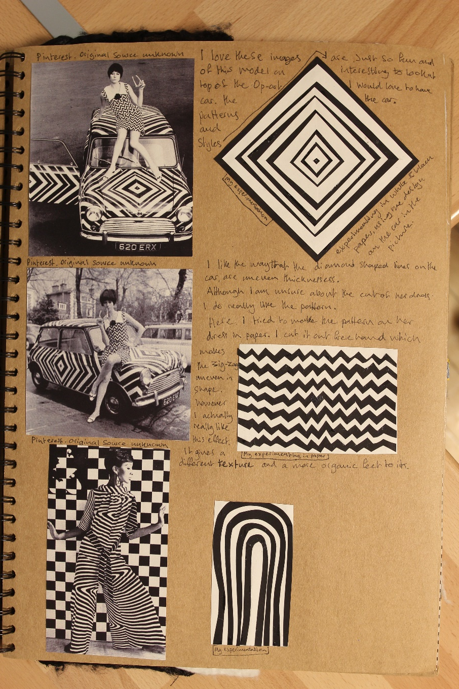
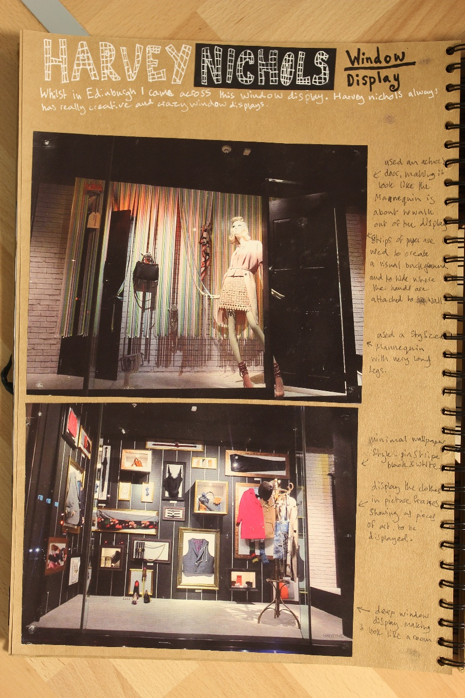
Sample Marked Learner Work | A2: Art and Design Project
23

Slide 24
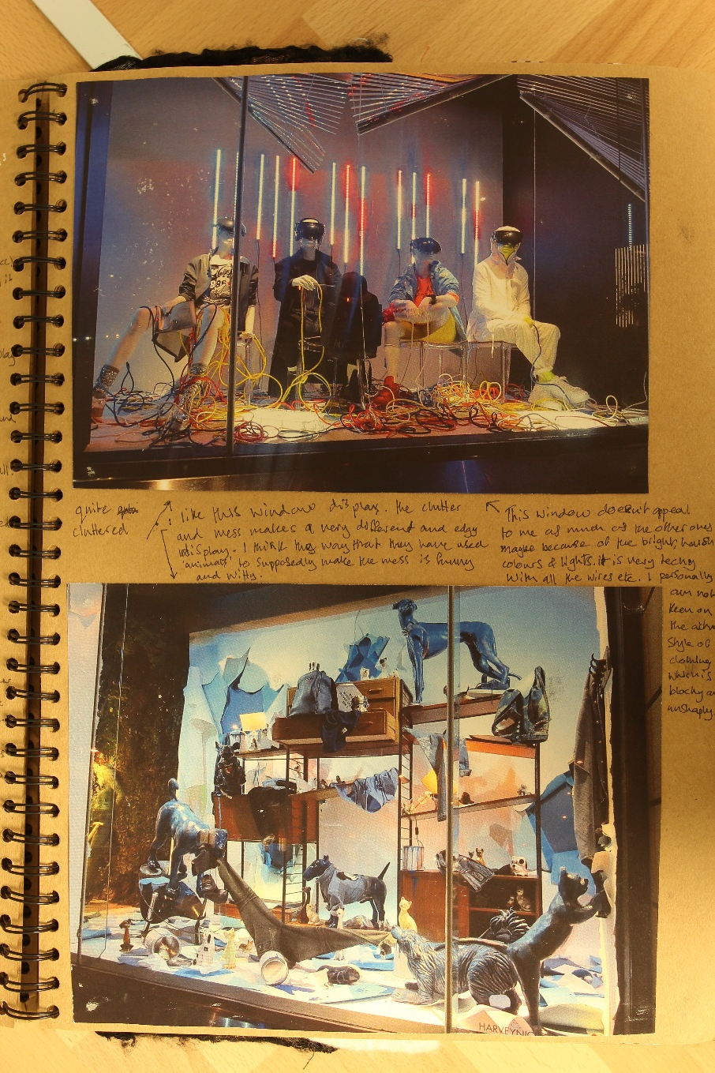
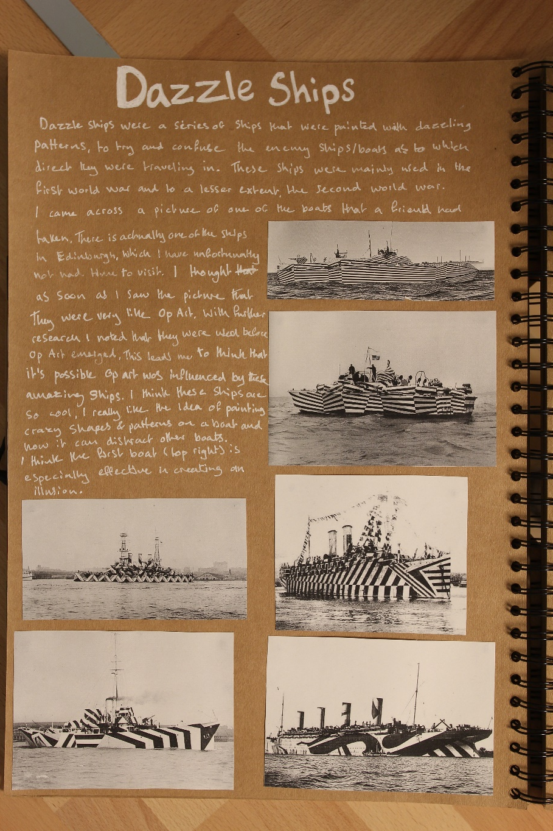
Sample Marked Learner Work | A2: Art and Design Project
24

Slide 25
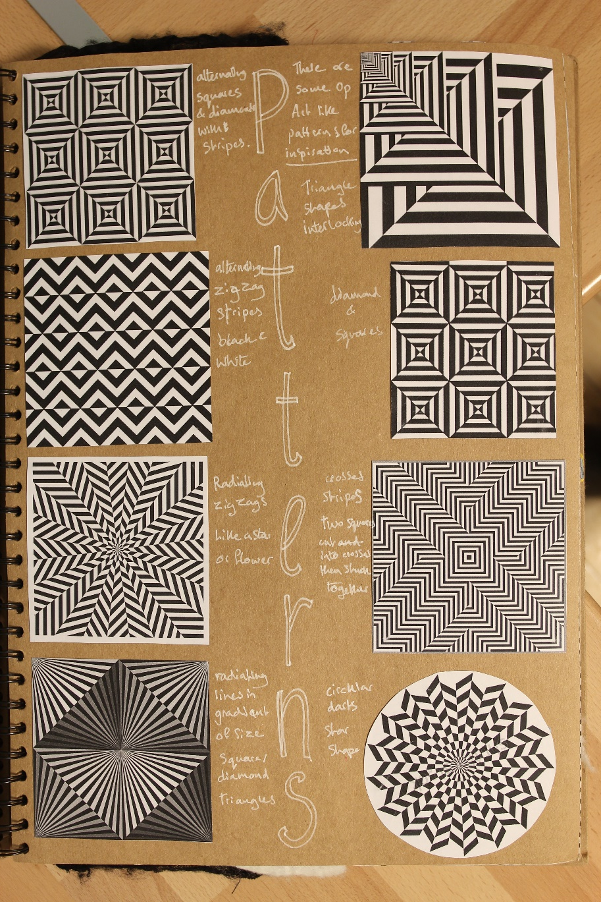
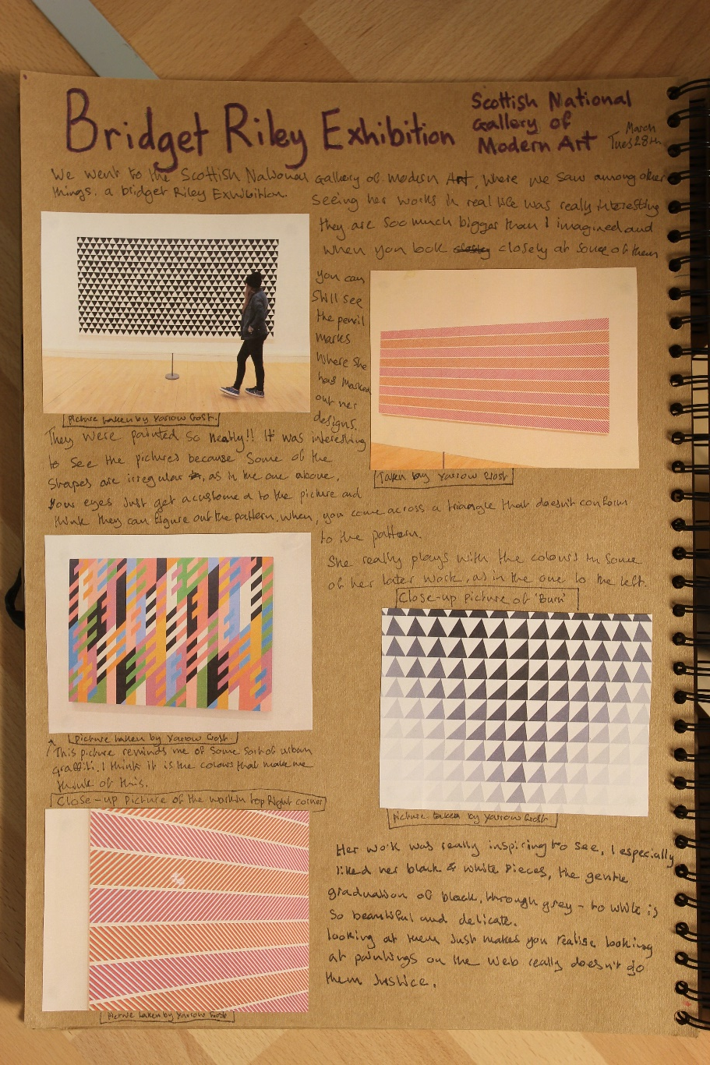
Sample Marked Learner Work | A2: Art and Design Project
25

Slide 26
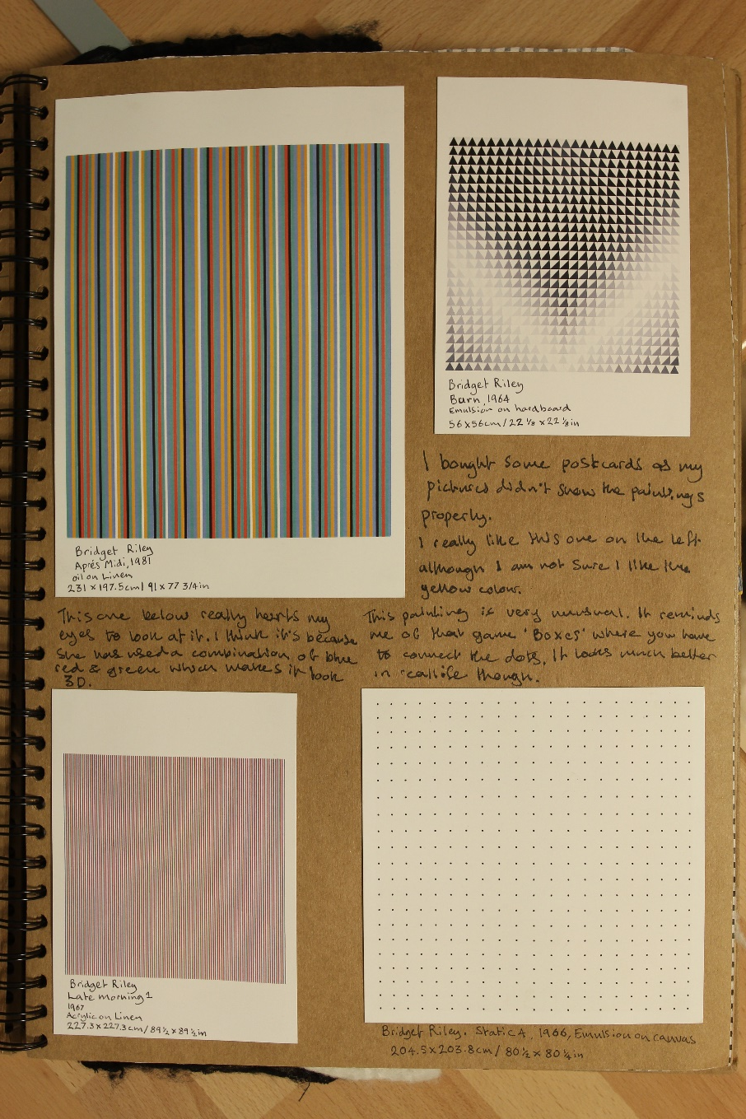
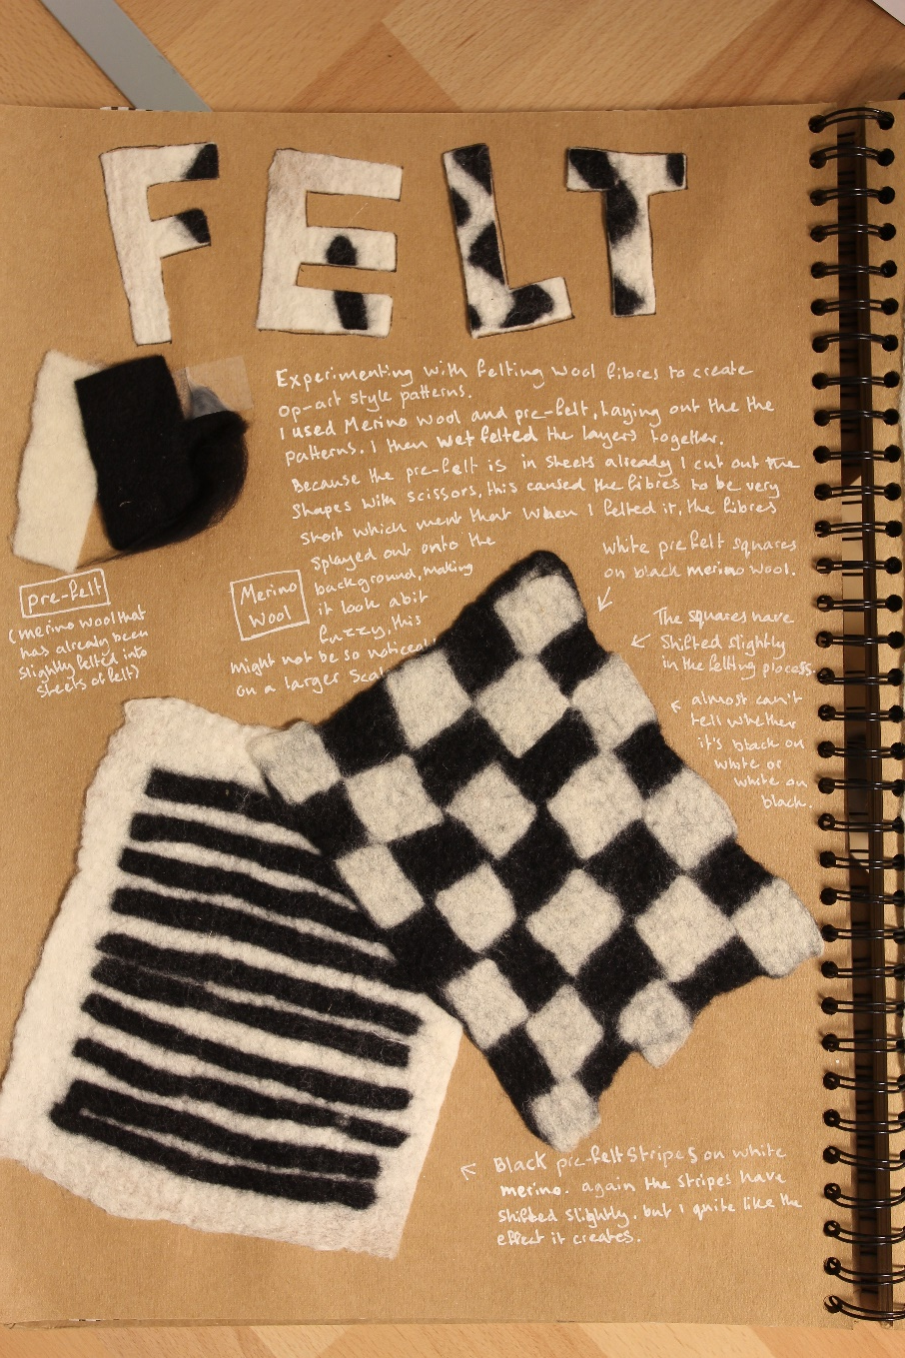
Sample Marked Learner Work | A2: Art and Design Project
26

Slide 27
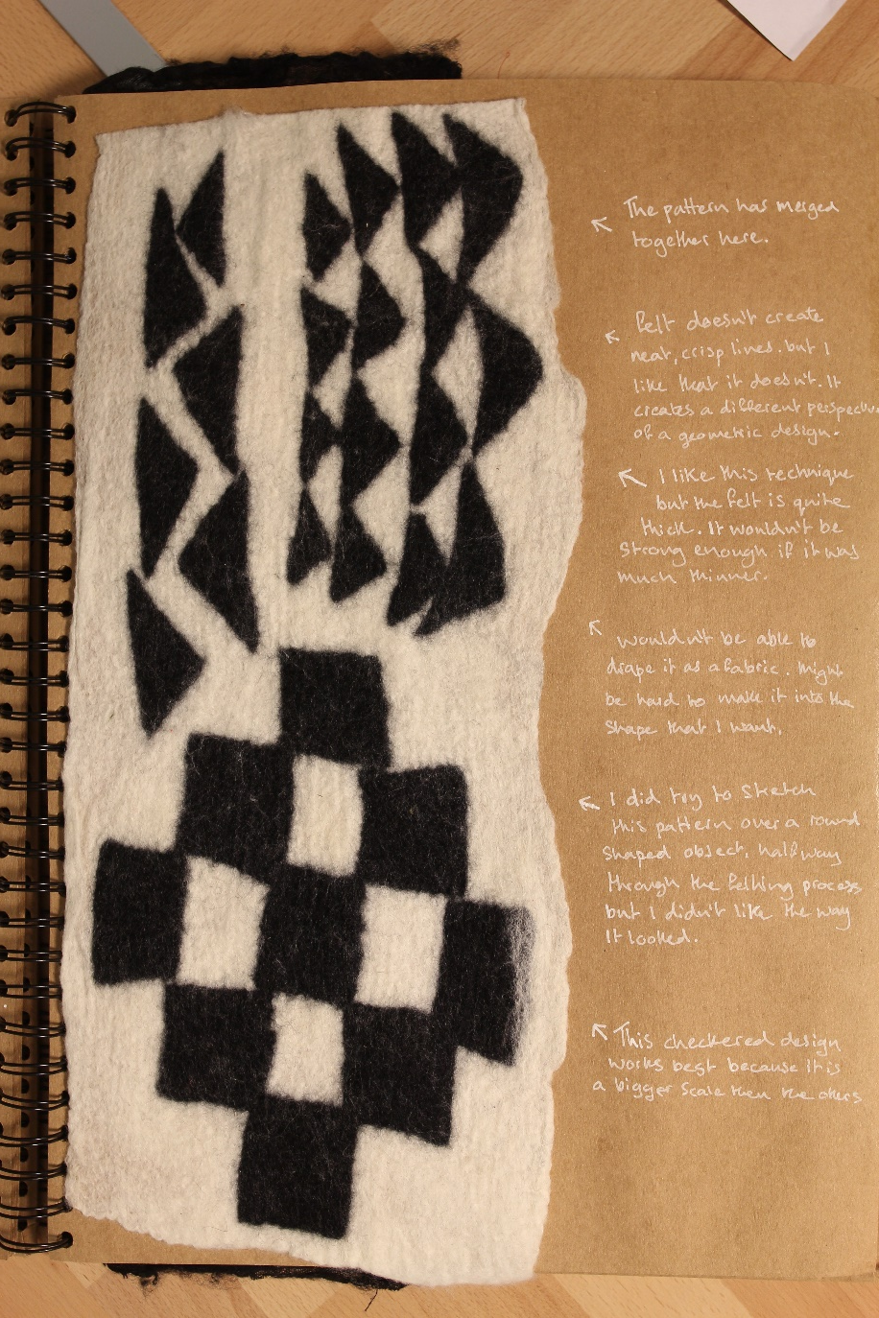
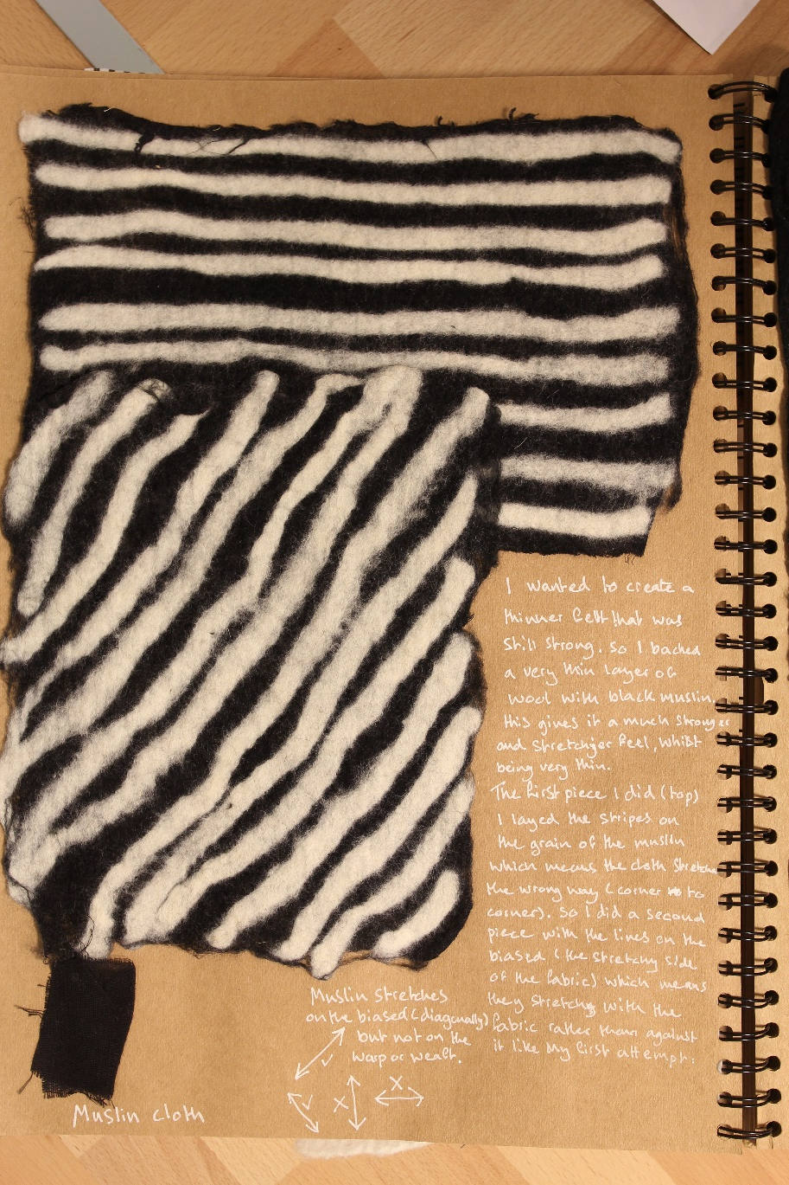
Sample Marked Learner Work | A2: Art and Design Project
27

Slide 28
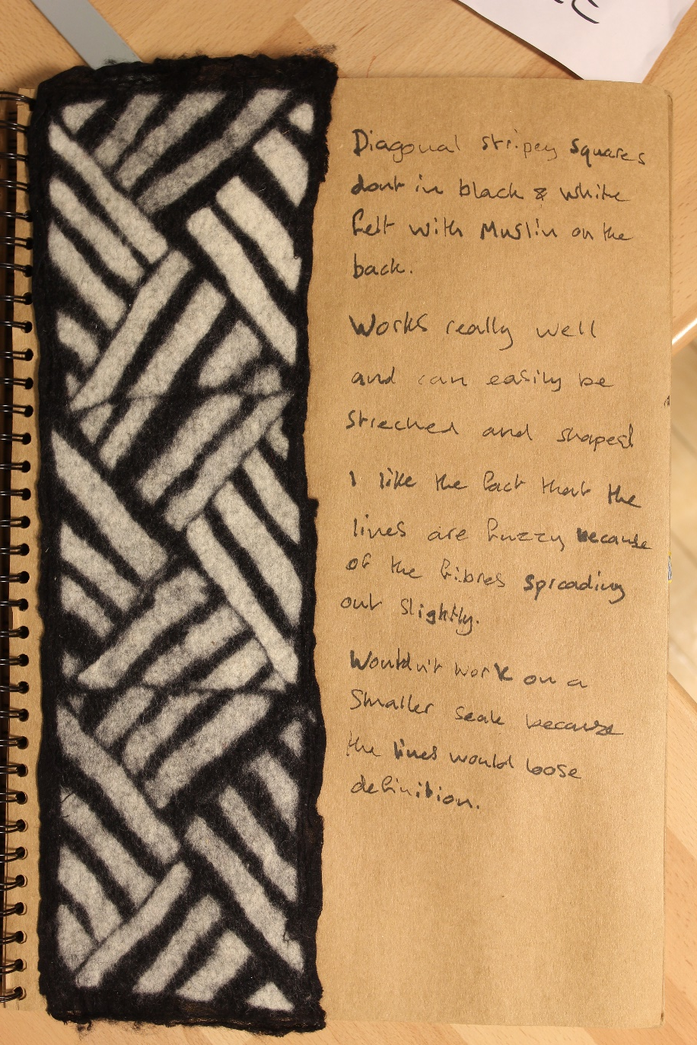
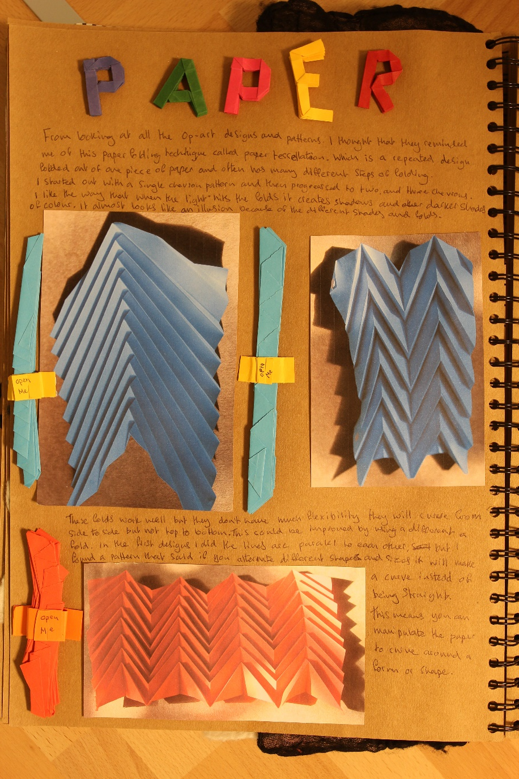
Sample Marked Learner Work | A2: Art and Design Project
28

Slide 29
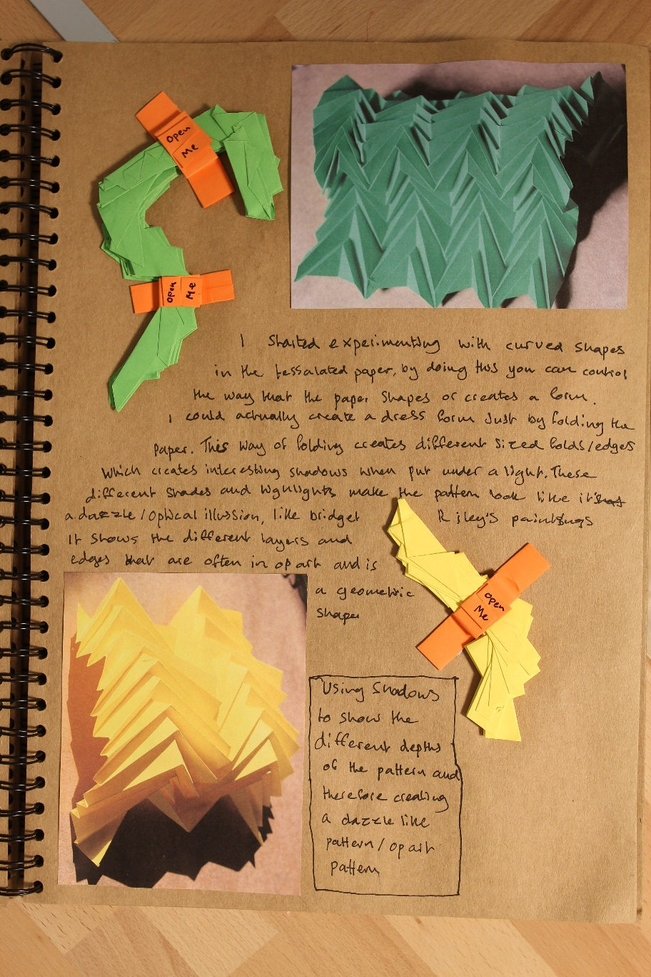
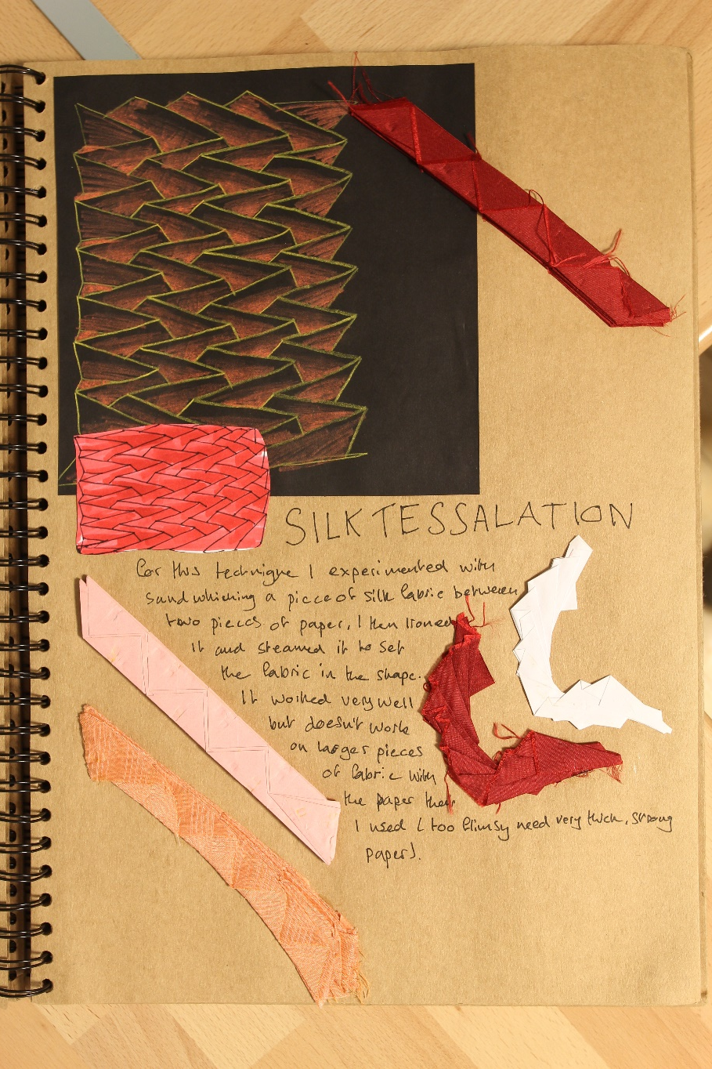
Sample Marked Learner Work | A2: Art and Design Project
29

Slide 30
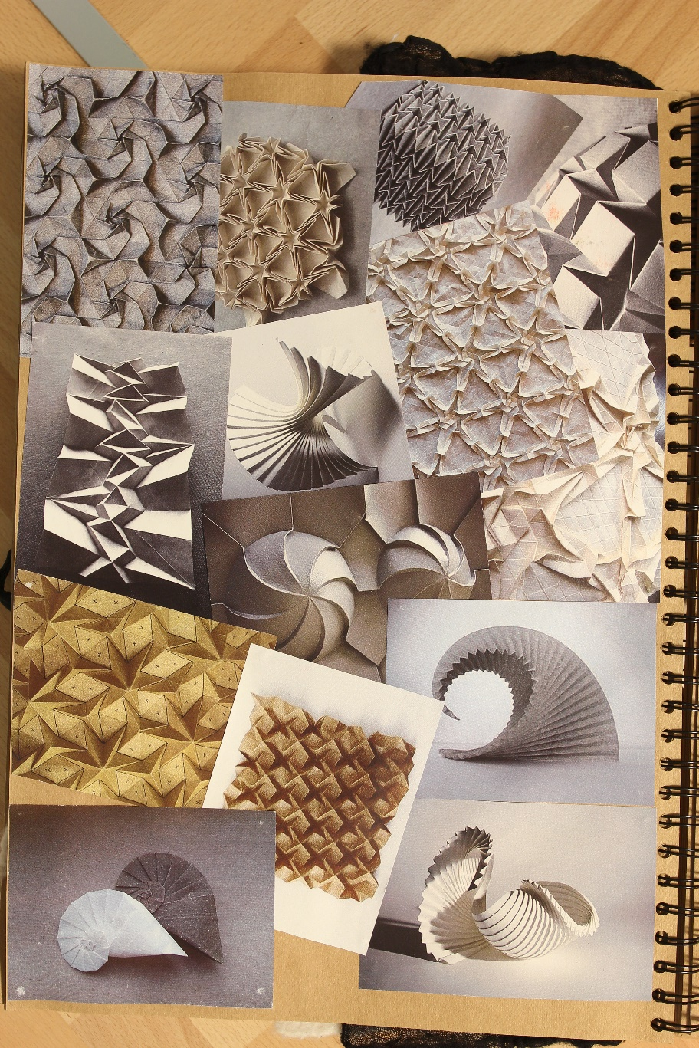
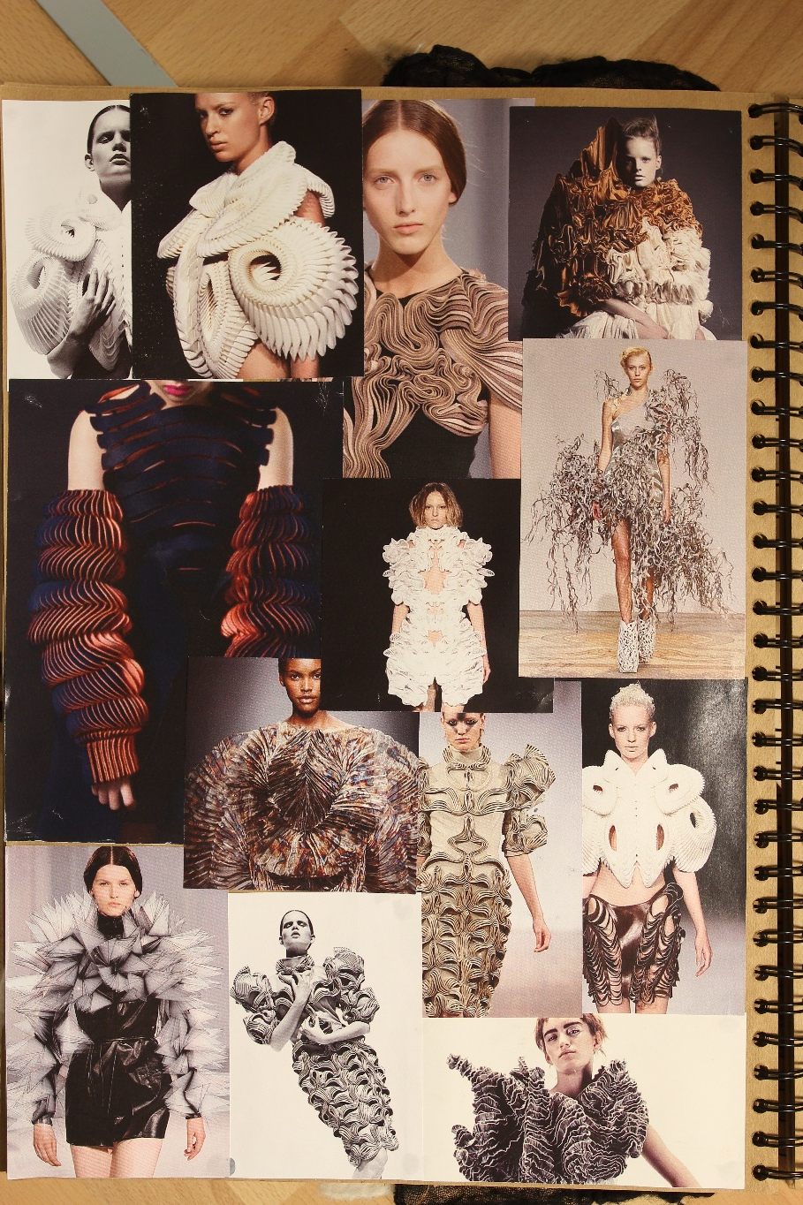
Sample Marked Learner Work | A2: Art and Design Project
30

Slide 31
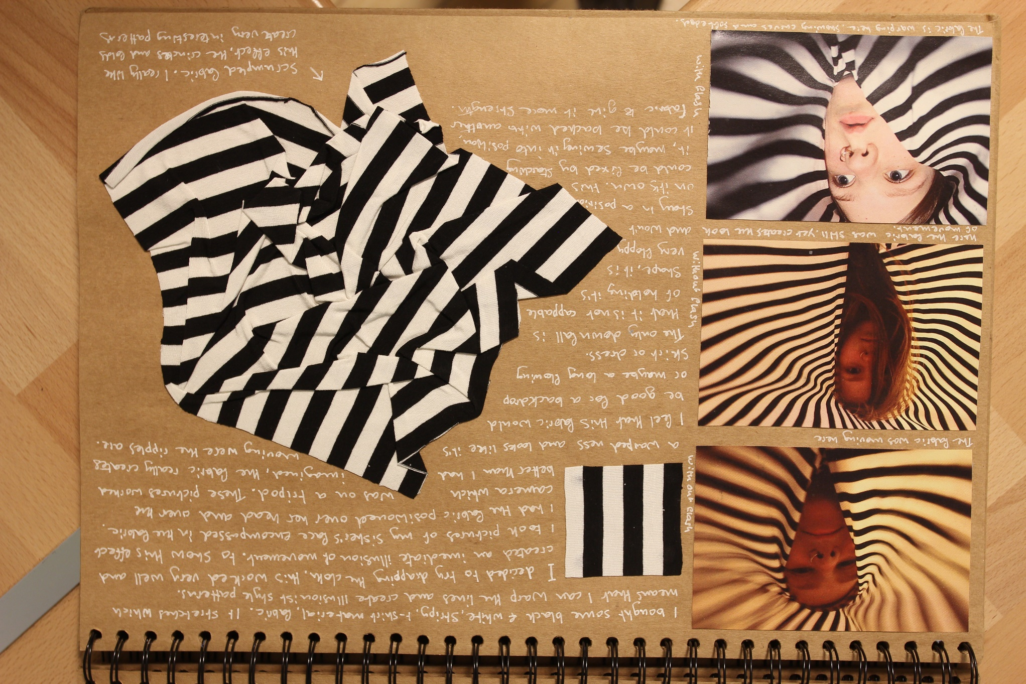
Sample Marked Learner Work | A2: Art and Design Project
31

Slide 32
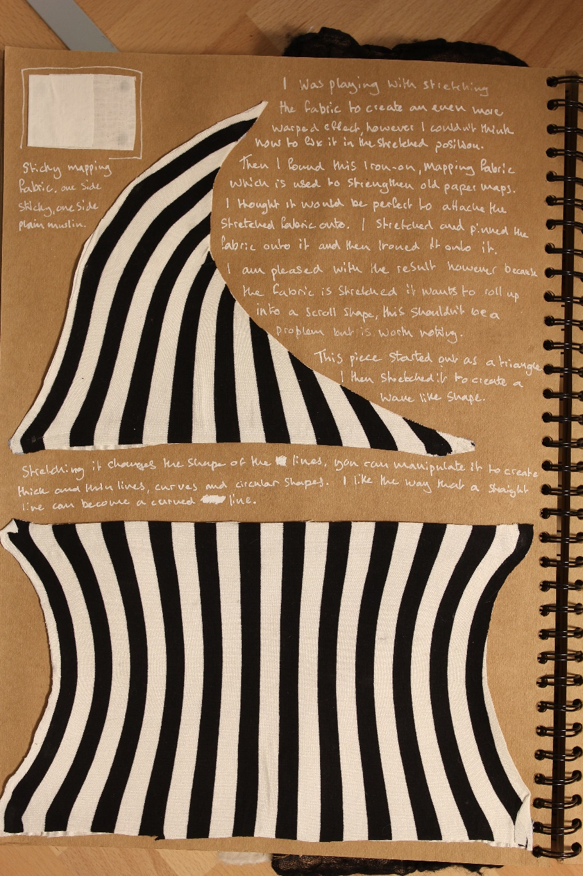
Sample Marked Learner Work | A2: Art and Design Project
32

Slide 33
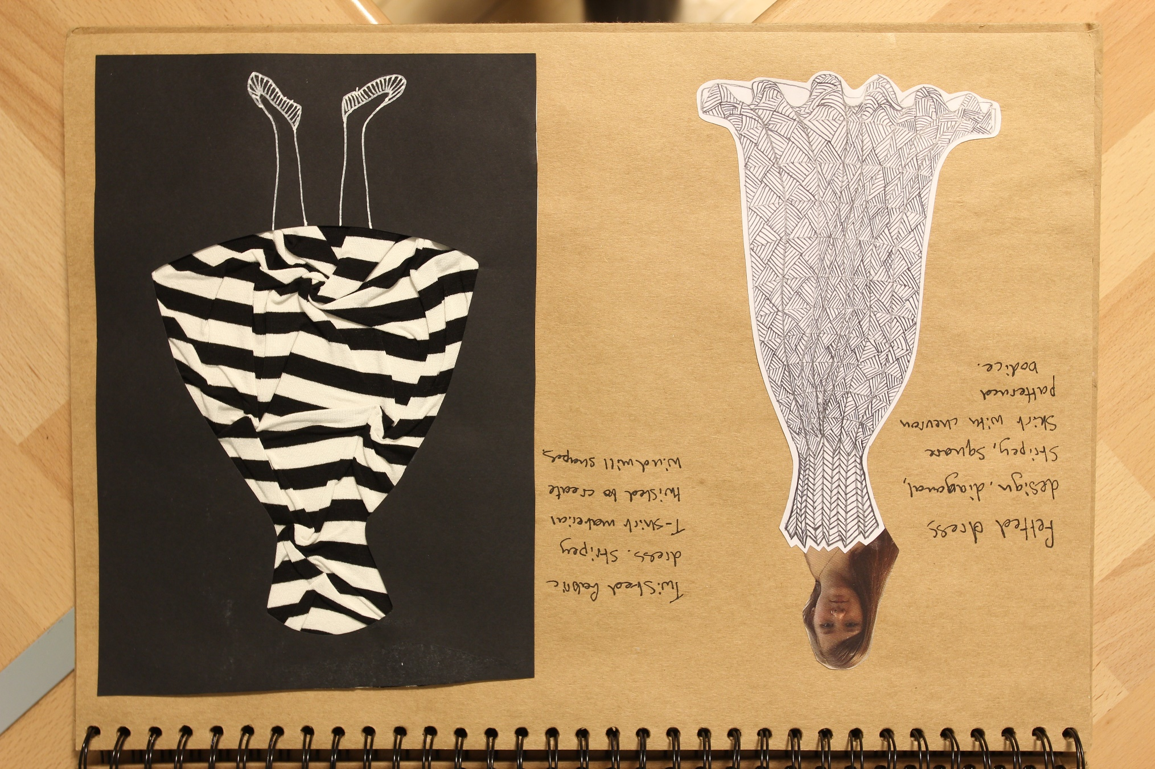
Sample Marked Learner Work | A2: Art and Design Project
33

Slide 34
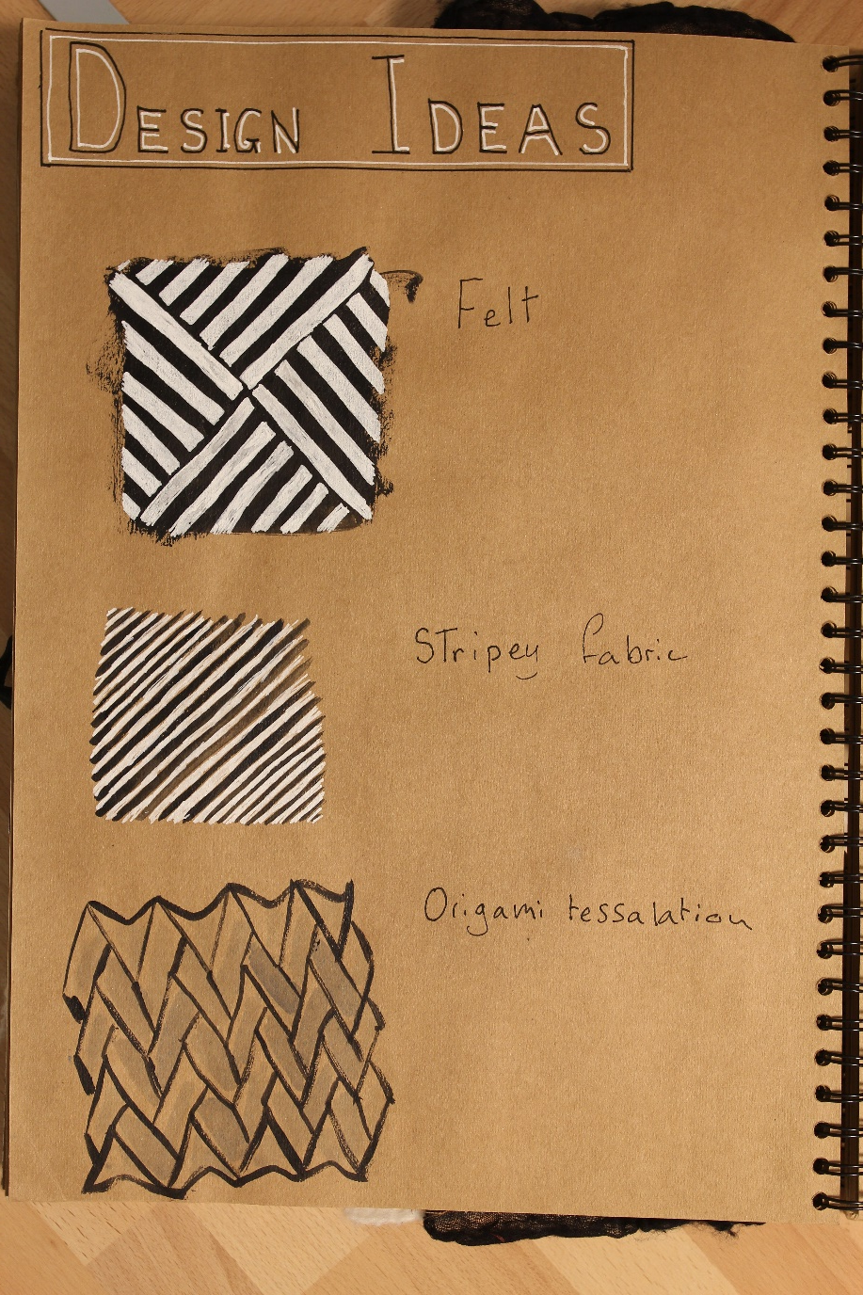
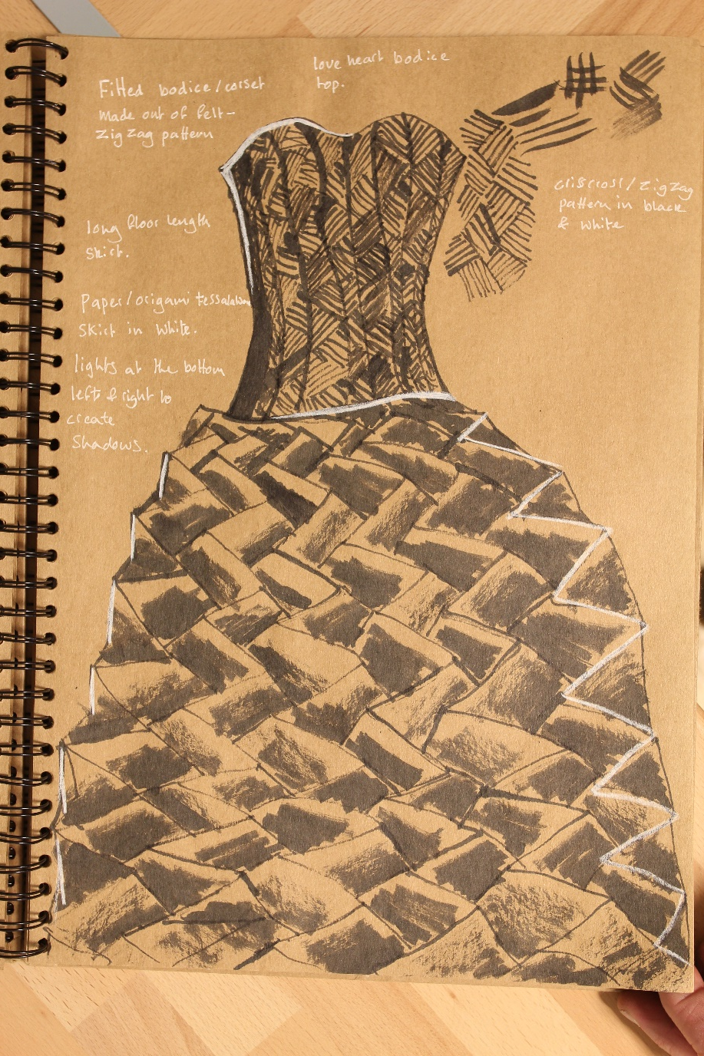
Sample Marked Learner Work | A2: Art and Design Project
34

Slide 35
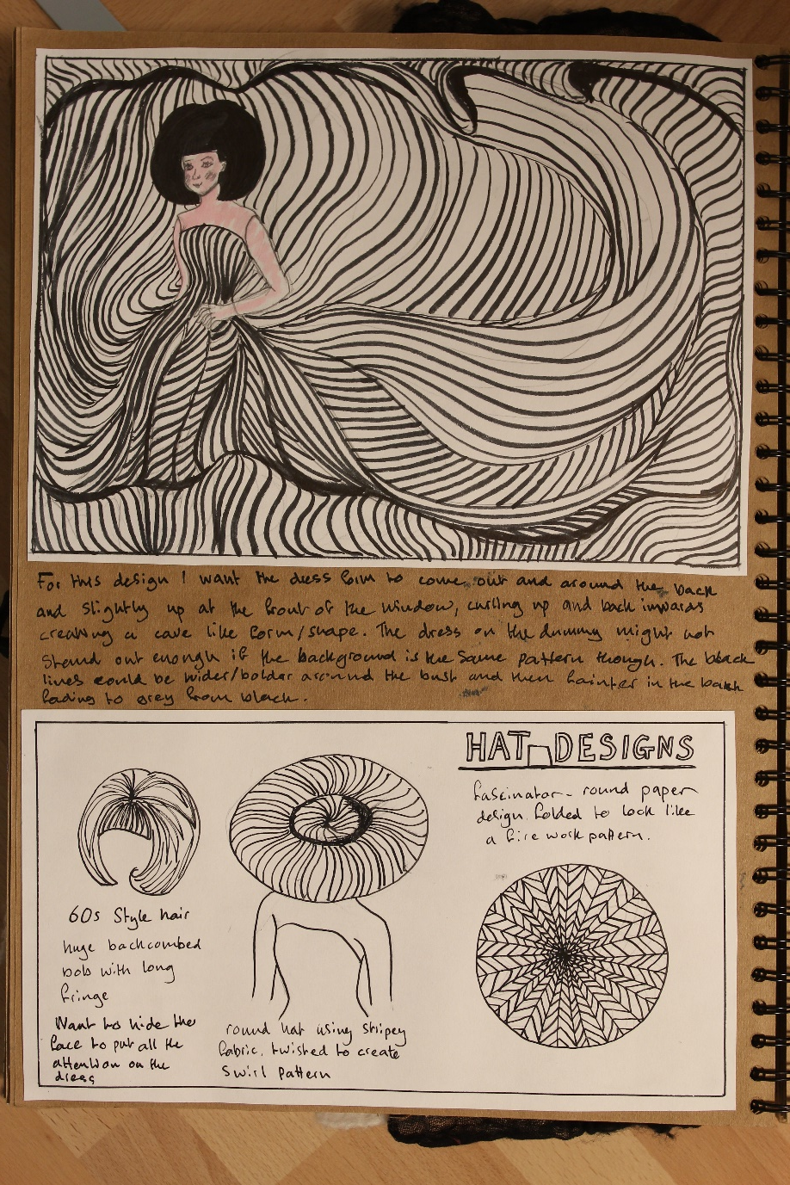
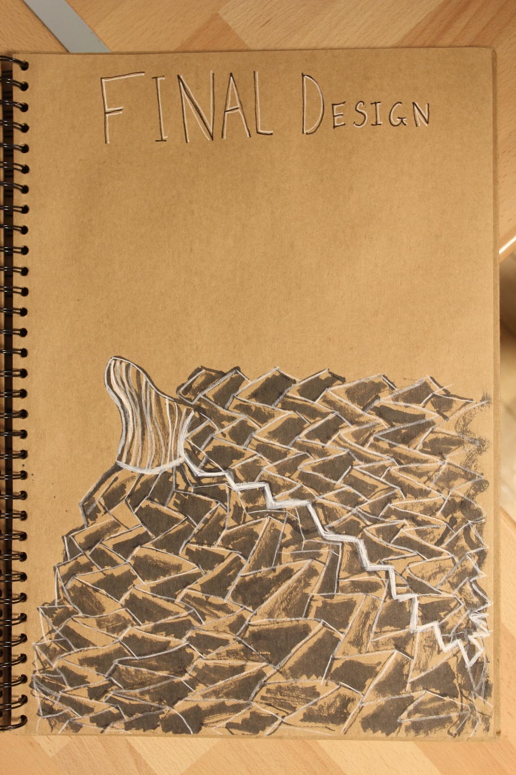
Sample Marked Learner Work | A2: Art and Design Project
35

Slide 36
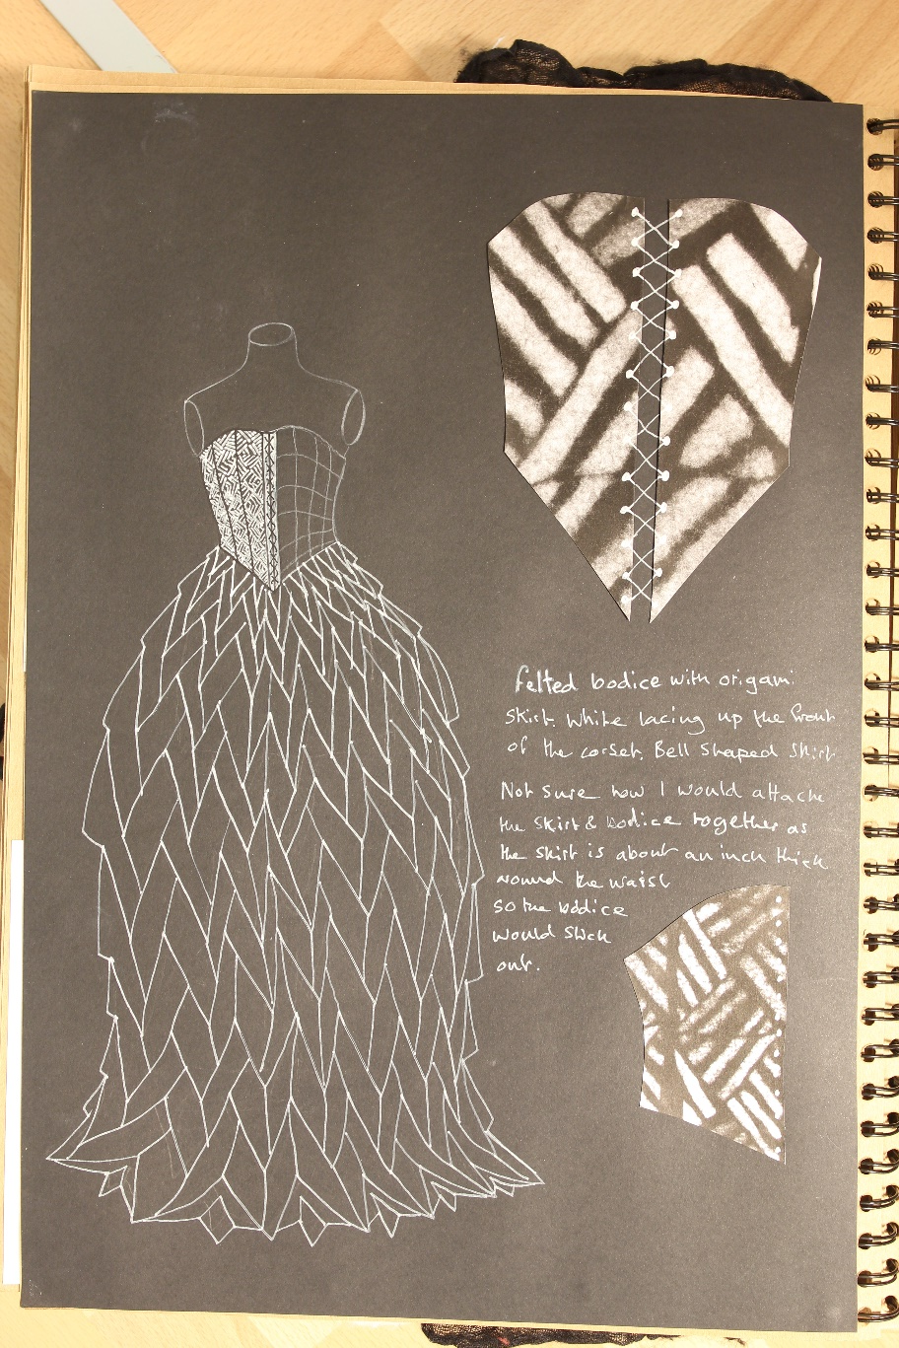
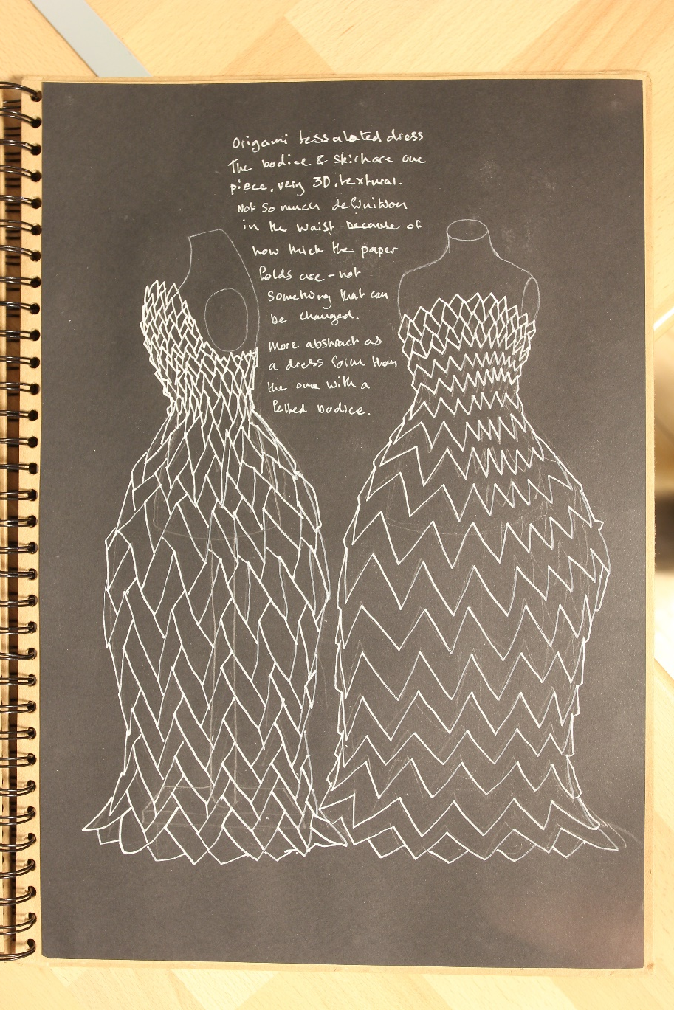
Sample Marked Learner Work | A2: Art and Design Project
36

Slide 37
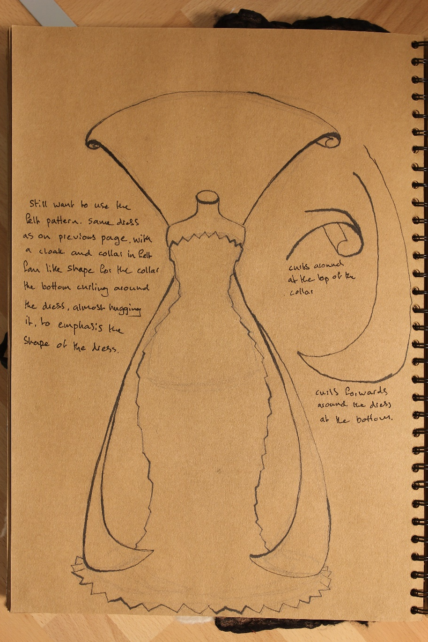
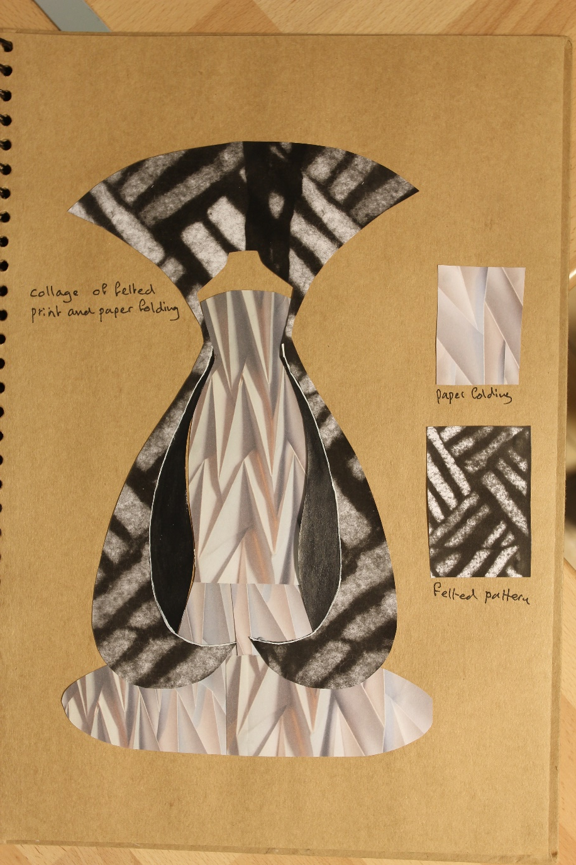
Sample Marked Learner Work | A2: Art and Design Project
37

Slide 38
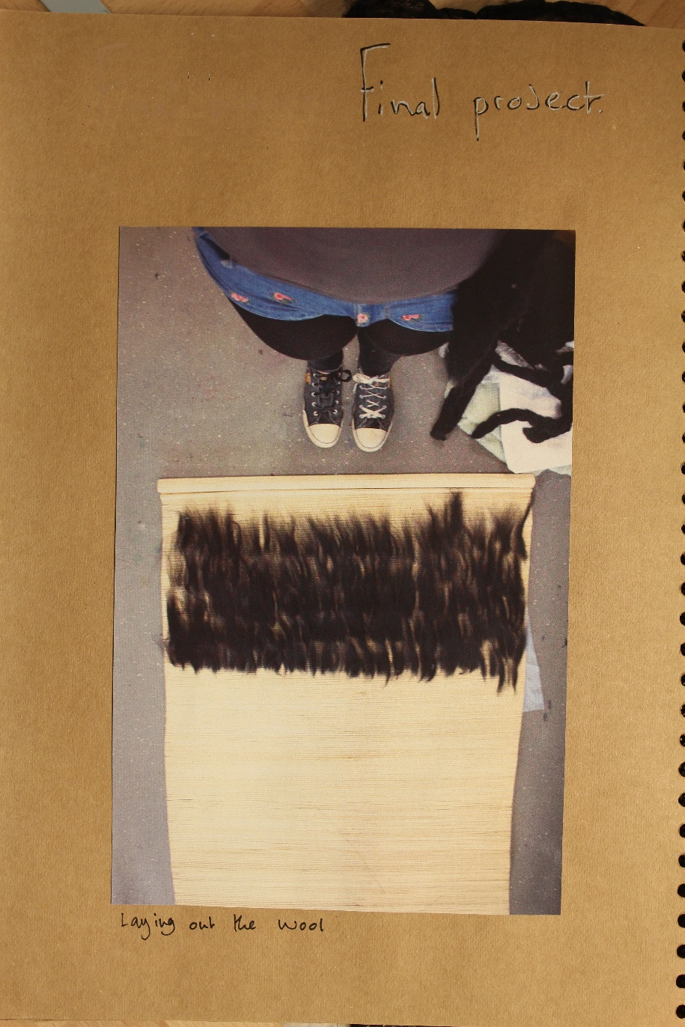

Sample Marked Learner Work | A2: Art and Design Project
38

Slide 39


Sample Marked Learner Work | A2: Art and Design Project
39

Slide 40


Sample Marked Learner Work | A2: Art and Design Project
40

Slide 41


Sample Marked Learner Work | A2: Art and Design Project
41

Slide 42

Sample Marked Learner Work | A2: Art and Design Project
42

Slide 43
Record of Practical Activity
Sample Marked Learner Work | A2: Art and Design Project
43

Slide 44

Assessment Record
Sample Marked Learner Work | A2: Art and Design Project
44

Slide 45

Assessment Record
Sample Marked Learner Work | A2: Art and Design Project
45

